Slide 1
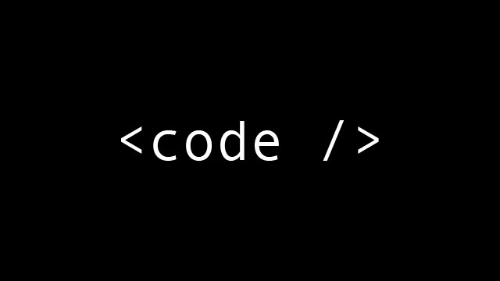
Top 8 Best Programming Languages To Learn

Slide 2
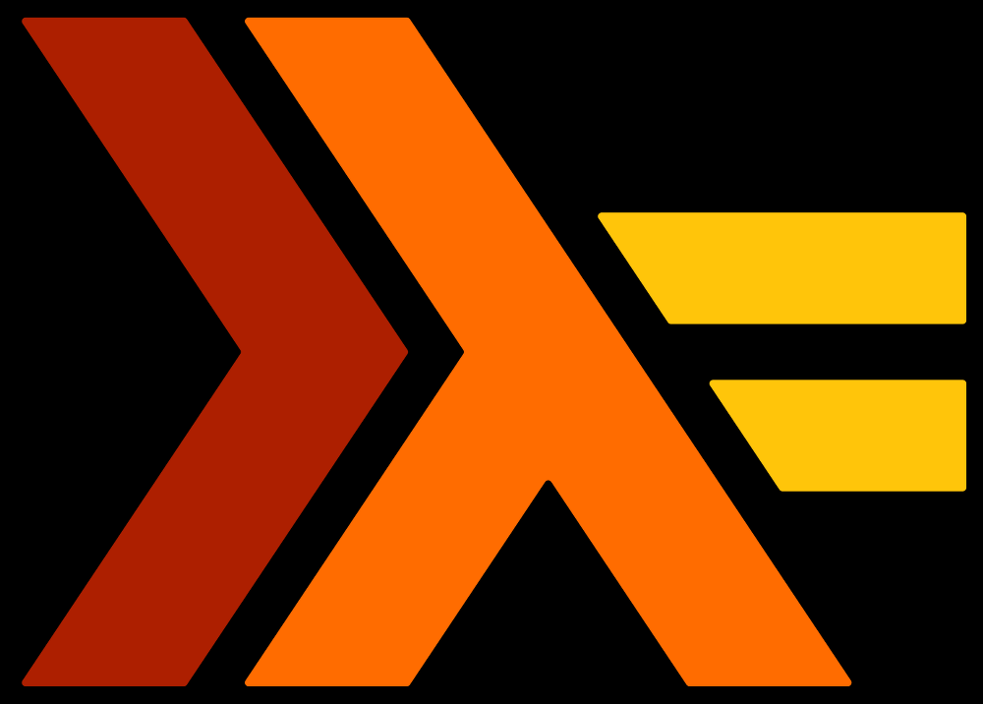
Number 8 Haskell
Learning haskell will change the way you think about programming.
Comprehensive documentation
A job with this language will most likely pay very well
Functional Language

Slide 3

Number 7 PHP
It's a quick and easy server side scripting language for web development and general use.
It works well with databases, file systems, images.
Large community, widely used. Most problems faced by a web developer have pre existing solutions.
Shallow learning curve for simple tasks. <?php echo "Hello world!"; ?> Place this in a file with the .php extension somewhere on your Apache server, and point your web browser to that file. Nothing to compile, no configuration files to edit

Slide 4
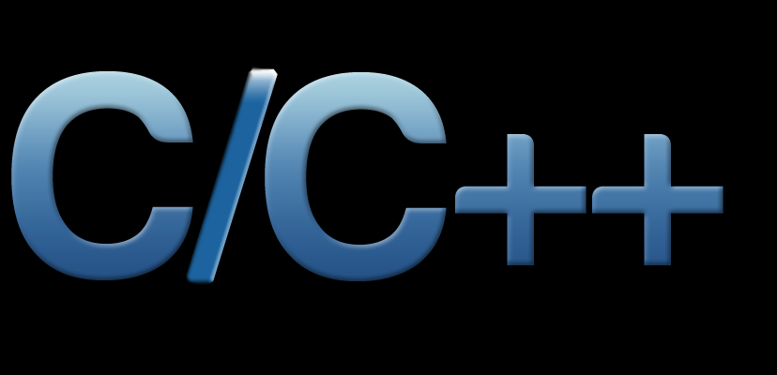
Number 6 C++
Combines the low level power of C with several layers of abstraction.
You can do imperative, functional, declarative and OO style programming.
There is a compiler for C++ on every major operating system.

Slide 5
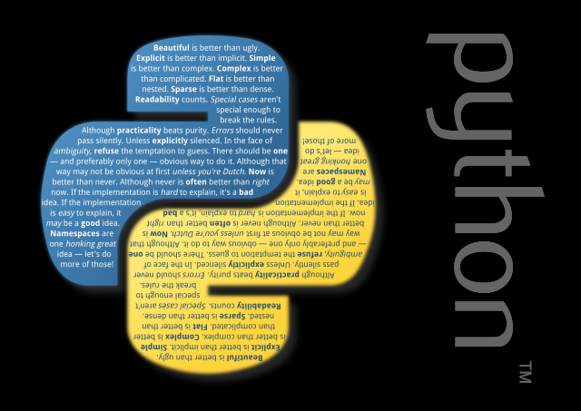
Number 5 Python
Open Source Community Development
Extensive Support Libraries
Easy to learn
Third party modules

Slide 6
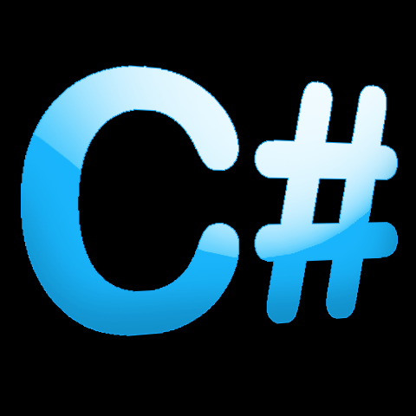
Number 4 C#
C# is a statically typed language, meaning it is unbiguous and you can catch a lot of errors at compile time, meaning they won't ever reach the customer.
Cross Platform / Multiple Platforms
Visual Studio is the IDE and considered one of the best
Can use the .NET Framework
Is used to create games in Unity

Slide 7

Number 3 JavaScript
Language formerly used exclusively for client-side functionality that runs in users' web browsers, but now also used as a server-side language in some cases (using Node.js)
Speed. Being client-side, JavaScript is very fast because any code functions can be run immediately instead of having to contact the server and wait for an answer.
JavaScript plays nicely with other languages and can be used in a huge variety of applications. Unlike PHP or SSI scripts, JavaScript can be inserted into any web page regardless of the file extension. JavaScript can also be used inside scripts written in other languages such as Perl and PHP.

Slide 8

Number 2 Java
The syntax is familiar to the myriad programmers that know any other C based language.
Comprehensive documentation
Good portability (One program can be run on many different platforms)
Object Oriented

Slide 9

Number 1 SQL
The standard language to communicate with Relational Database Management Systems (RDBMS)
It’s been here over 30 years and still going strong
It’s mostly standardized
Easy to learn
No Viable Alternatives Available for speaking to RDBMS

Slide 10
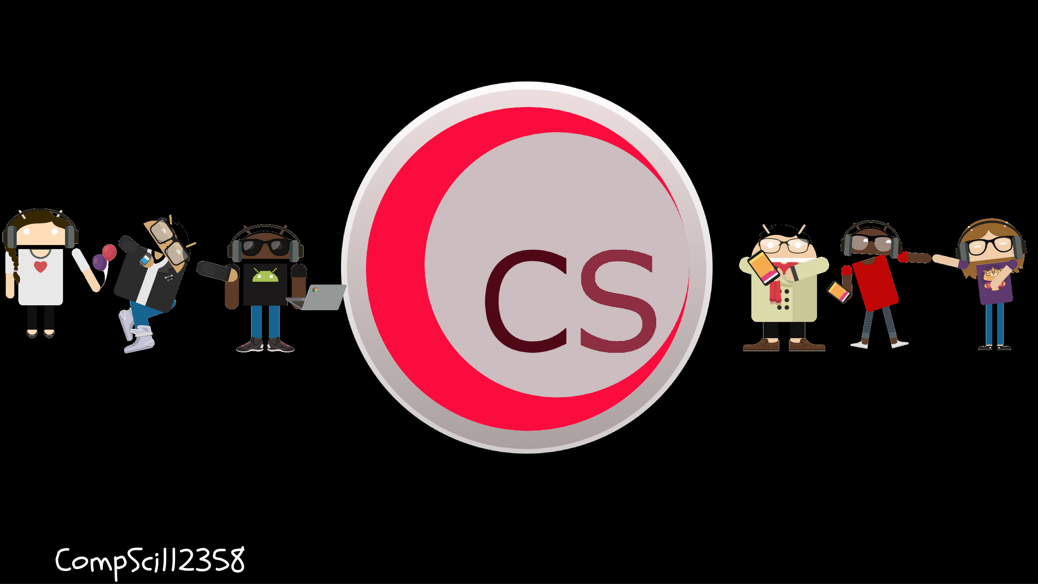
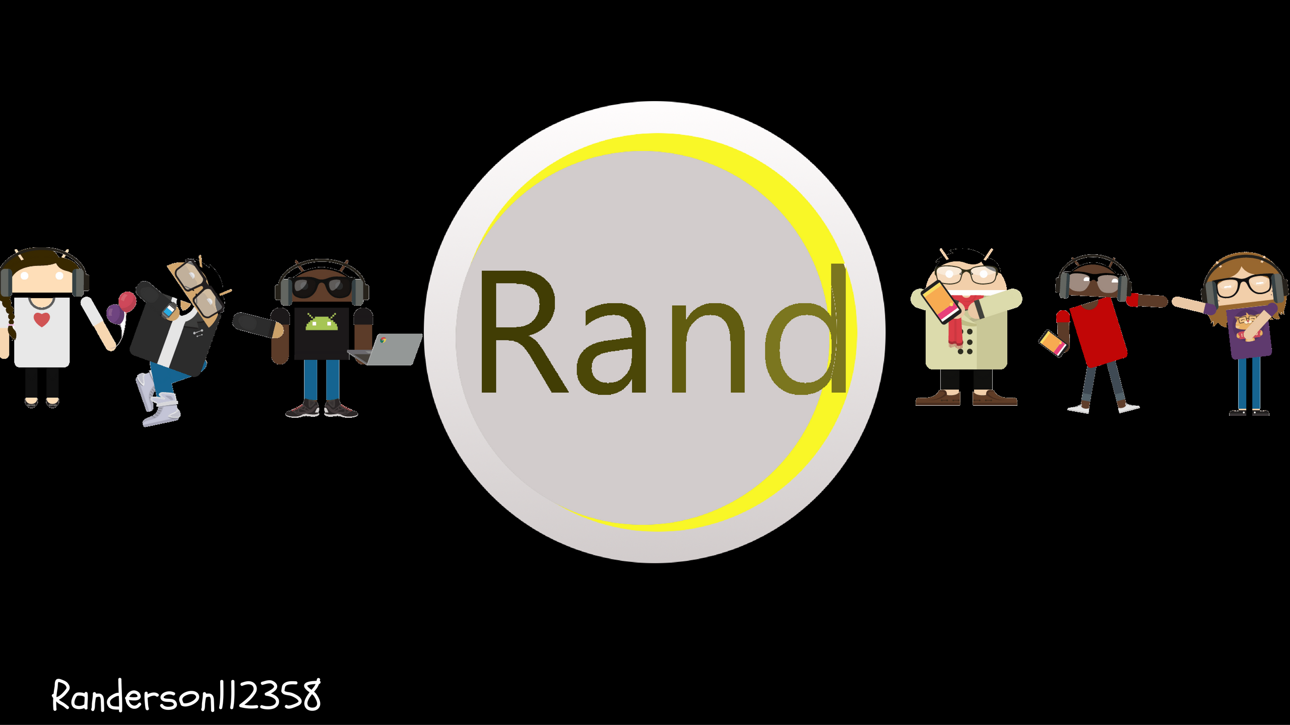

Please Subscribe !

